Slide 1
COVID vs NASDAQ COMPOSITE
Project Partners: Brett Kaliner, Rishi Gupta, Sarah Wolberg

Slide 2
Background
Our research has very much pointed to the assumption that COVID-19 has had a negative impact on the global economy and financial markets. This is due to significant reductions in income, a rise in unemployment, and disruptions in the transportation, service, and manufacturing industries. Proactive international actions are required to save lives and protect economic prosperity.
In our analysis, we will take a look at the data of NASDAQ composite and try see if COVID-19 and other external factors affected the global economy and financial markets as stated in our research.

Slide 3
Model Development: Initial Evaluation and Data Analysis Plan
Initial Evaluation
When the assumption of data normally distributed is violated or the relationship between the dependent and independent variables in case of linear model are not linear, such as the NASDAQ Model, in such situations some transformations methods that may help the data set follow a normal distribution. Box Cox is one such transformation method. In the next part of this research and analysis, we will show two different models in order to best compare which model is best of the three models.
Data Analysis Plan
Gather data from relevant ETFs, the NASDAQ, interest rates, inflation rates, GDP, unemployment rate, and COVID.
Clean the data in excel to make it useful for our analysis
Put the data into R with read excel package to prepare for analysis
Filter all data to include only relevant dates where COVID was a present threat
Develop preliminary linear models
Use ANOVA to check for significant variables in each model
Update the models to include on the significant variables
Check the summaries of the models to ensure they are all accurate models (high adjusted R-squared)
Make relevant transformations to increase model validity
Plot the models to check for leverage points and outliers and determine what to do with these points
Added variable plots which (avp) which will show us which variables are significant if lines are non-flat.
Check for multicollinearity using vif.

Slide 4
Research Questions
Which variables are significant factors in determining stock market value?
Has the total daily number of US COVID cases affected the stock market value since March 2020 until March 2021?

Slide 5
Data Description and Data Resources
Quantitative
Time based
Data | Variable | Date Accessed | Site Accessed
NASDAQ Composite(^IXIC) | Y | 3/29/21 | https://finance.yahoo.com/quote/%5EIXIC/history?period1=1522281600&period2=1616976000&interval=1d&filter=history&frequency=1d&includeAdjustedClose=true
Inflation Rates | X₁ | 3/29/21 | https://fred.stlouisfed.org/graph/?g=cN69
Interest Rate Data | X₂ | 3/29/21 | https://www.treasury.gov/resource-center/data-chart-center/interest-rates/Pages/TextView.aspx?data=reallongtermrateAll
GDP | X₃ | 3/29/21 | https://fred.stlouisfed.org/graph/?g=cN69
Unemployment Data | X₄ | 3/29/21 | https://fred.stlouisfed.org/series/UNRATE
COVID Case Data | X₅ | 3/29/21 | https://ourworldindata.org/coronavirus/country/united-states

Slide 6
Initial Model Variables
Variable Y: NASDAQ Closing Value = Dependent Variable
Variable X₁: Interest Rates = Independent Variable
Variable X₂: Inflation= Independent Variable
Variable X₃: Gross Domestic Product (GDP) = Independent Variable
Variable X₄: National Unemployment Rates = Independent Variable
Variable X₅: Total Daily Number US COVID Cases = Independent Variable

Slide 7
Hypothesis
H_{o}: COVID-19 did not affect the global markets such as NASDAQ Composite.
H₁: COVID-19 did affect the global markets such as NASDAQ Composite.

Slide 8
Model Development: Exploratory Data Analysis
Initial Linear Model
NASDAQ Closing Value= X₁ (Interest Rates) + X₂ (Inflation Rates) + X₃ (GDP Rate) + X₄ (Unemployment Rates) + X₅ (Number of New COVID Cases)

Slide 9
Model Development: Exploratory Data Analysis
Data Summary : NASDAQ Closing Model. What we see is that the p-value for all of the variables in the equation are all less than 0.05. This means that they are statistically significant in this relationship. However, when we look at the R2 value, it is 0.7765 which means that the model is not as strong as we would like it to be. This is a clue that we will need to conduct further tests on this data set to fully determine how to make the model stronger.
Data Summary 1: NASDAQ Closing Model
summary(marketLM)
## ## Call: ## lm(formula = nasdaq$Close ~ interestRates$Rate + inflationRate$Rate + ## GDP$`GDP Rate` + unemploymentRate$Rate + COVID$new_cases) ## ## Residuals: ## Min 1Q Median 3Q Max ## -3147.16 -447.47 -64.91 598.31 2178.98 ## ## Coefficients: ## Estimate Std. Error t value Pr(>|t|) ## (Intercept) 1.589e+04 3.960e+02 40.137 < 2e-16 *** ## interestRates$Rate -3.234e+03 3.548e+02 -9.117 < 2e-16 *** ## inflationRate$Rate -8.145e+02 2.201e+02 -3.701 0.000255 *** ## GDP$`GDP Rate` -6.731e+02 6.444e+01 -10.446 < 2e-16 *** ## unemploymentRate$Rate -6.928e+02 4.201e+01 -16.492 < 2e-16 *** ## COVID$new_cases 5.327e-03 1.055e-03 5.051 7.6e-07 *** ## --- ## Signif. codes: 0 '***' 0.001 '**' 0.01 '*' 0.05 '.' 0.1 ' ' 1 ## ## Residual standard error: 867 on 305 degrees of freedom ## Multiple R-squared: 0.7765, Adjusted R-squared: 0.7728 ## F-statistic: 211.9 on 5 and 305 DF, p-value: < 2.2e-16

Slide 10
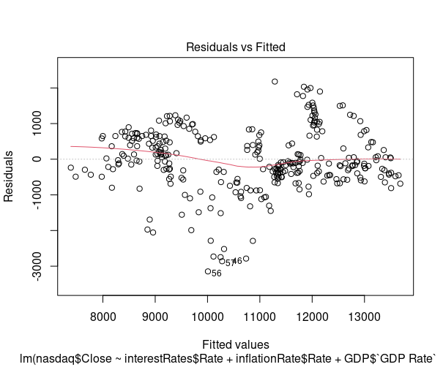
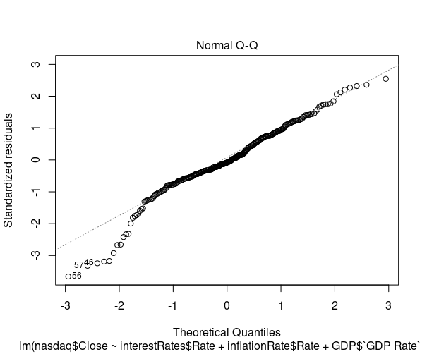
Model Development:Diagnostics
Here in Figure 1: NASDAQ Residuals vs. Fitted Values we see that linearity seems to hold reasonably well, as the red line is close to the dashed line. the fitted vs residuals plot, which allows us to detect several types of violations in the linear regression assumptions. We can also note the heteroskedasticity: as we move to the right on the x-axis, the spread of the residuals seems to be increasing. Finally, points 46, 56, and 57 may be outliers, with large residual values.
The Normal Q-Q Plot for Figure 2: NASDAQ Normal Q-Q shows many observations deviating from the dashed line. Additionally, the observations numbered as 46, 56, and 57 look a little off. These observations may be a potential problem. Looking at the QQ Plot and Standardized Residual Plot, we can identify some elements of weakness such as outliers such as 46, 56, and 57.

Slide 11
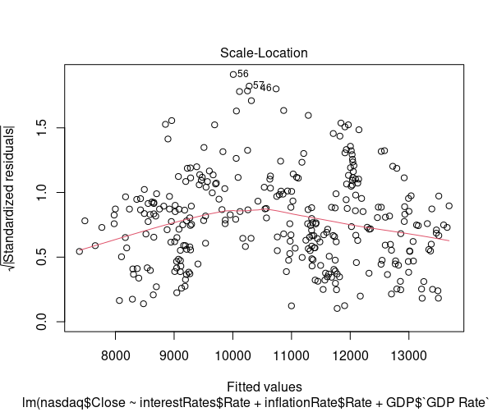
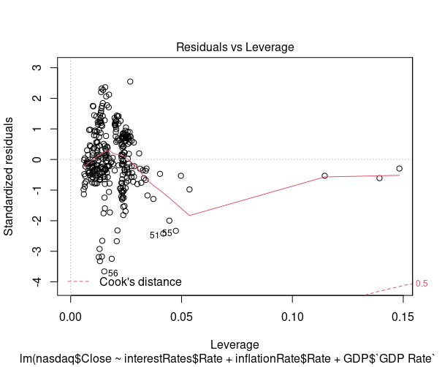
Model Development: Diagnostic Continued
Scale-Location plot for Figure 3: NASDAQ Scale-Location Plot shows whether residuals are spread equally along the ranges of input variables (predictor). The assumption of equal variance (homoscedasticity) could also be checked with this plot. If we see a horizontal line with randomly spread points, it means that the model is good. However, in the Scale-Location Plot for Figure 3: NASDAQ Scale-Location Plot, there seems to be a pattern that is not random. Hence, the variance is not equal. This means that we need to conduct a transformation process to fix the issue with Figure 3: NASDAQ Scale-Location Plot.
In the Figure 4: NASDAQ Residual vs. Leverage Plot for the NASDAQ Model we are looking at how the spread of standardized residuals changes as the leverage, or sensitivity of the fitted y-hat to a change in y, increases. Firstly, this can also be used to detect heteroskedasticity and non-linearity. The spread of standardized residuals shouldn’t change as a function of leverage. Here the spread appears to decrease, indicating heteroskedasticity. Second, points with high leverage may be influential. Deleting them would change the model a lot. For this we can look at Cook’s distance, which measures the effect of deleting a point on the combined parameter vector. Cook’s distance is the dotted red line here, and points outside the dotted line have high influence. In this case there are no points outside the dotted line. Therefore, we do not see any points of high influence. However, we also see points 51, 55, and 56 that are identified as possible outliers.

Slide 12
Model Development: Multicollinearity
To check for multicollinearity we will use vif function. We will get following results
vif(marketLM1)
interestRates$Rate inflationRate$Rate GDP$`GDP Rate`
3.890649 5.059490 7.554023
unemploymentRate$Rate COVID$new_cases
7.543277 1.973101
As a rule of thump cut-off for removing variable is 5 hence drop GDP Rate. So we created a second Model (Model 2) and see if taking GDP out of the model makes the model better.
Model 2: NASDAQ Closing Value= X₁ (Interest Rates) + X₂ (Inflation Rates) + X₄ (Unemployment Rates) + X₅ (Number of New COVID Cases)

Slide 13
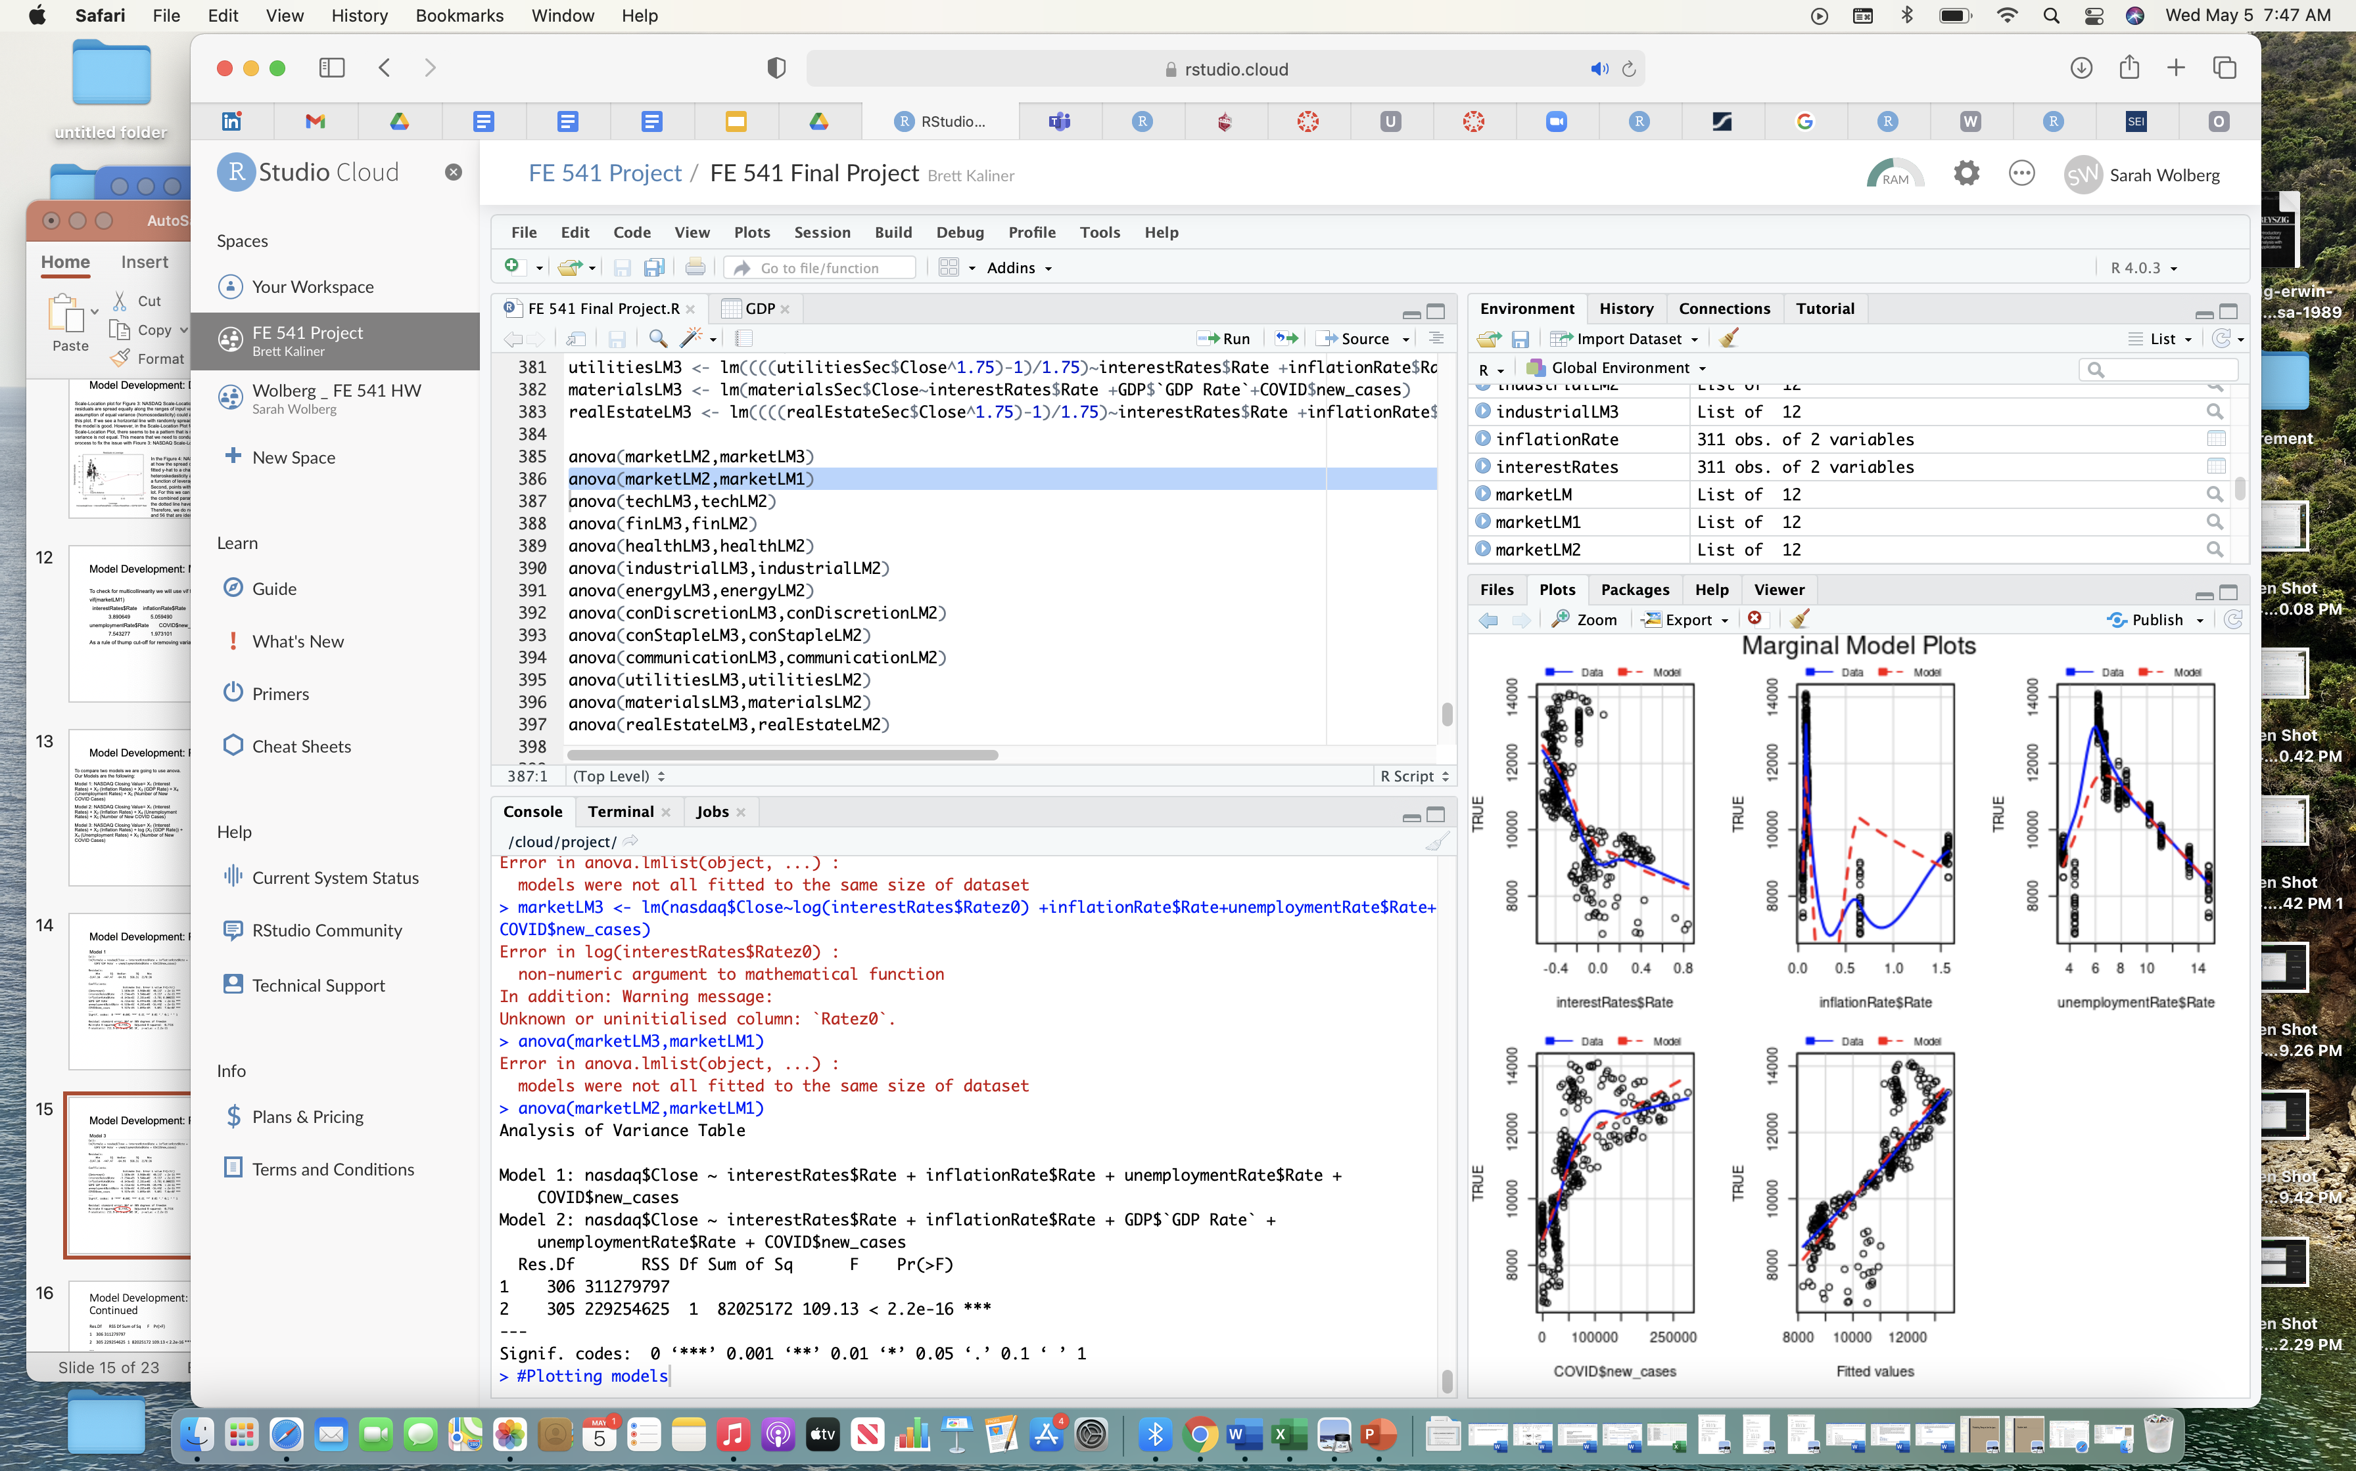
Model Development: Performance Comparison
Anova Output Comparing Model 1 &2
To compare two models we are going to use anova. Our Models are the following:
Model 1: NASDAQ Closing Value= X₁ (Interest Rates) + X₂ (Inflation Rates) + X₃ (GDP Rate) + X₄ (Unemployment Rates) + X₅ (Number of New COVID Cases)
Model 2: NASDAQ Closing Value= X₁ (Interest Rates) + X₂ (Inflation Rates) + X₄ (Unemployment Rates) + X₅ (Number of New COVID Cases)
Model 3: NASDAQ Closing Value= X₁ (Interest Rates) + X₂ (Inflation Rates) + log (X₃ (GDP Rate)) + X₄ (Unemployment Rates) + X₅ (Number of New COVID Cases)

Slide 14
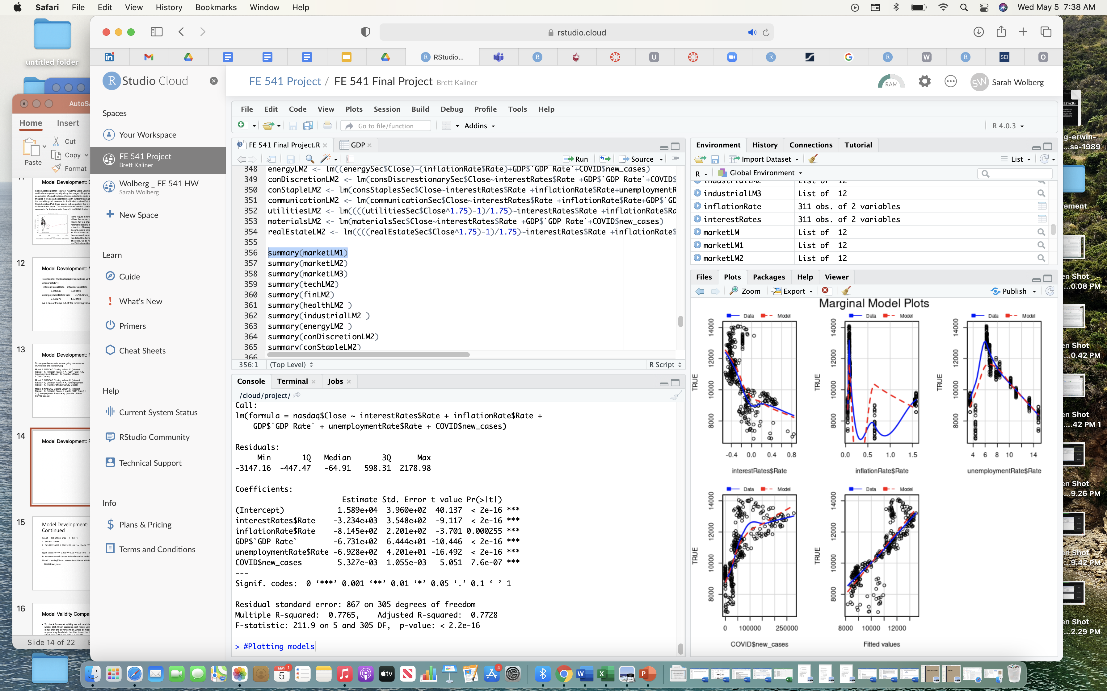
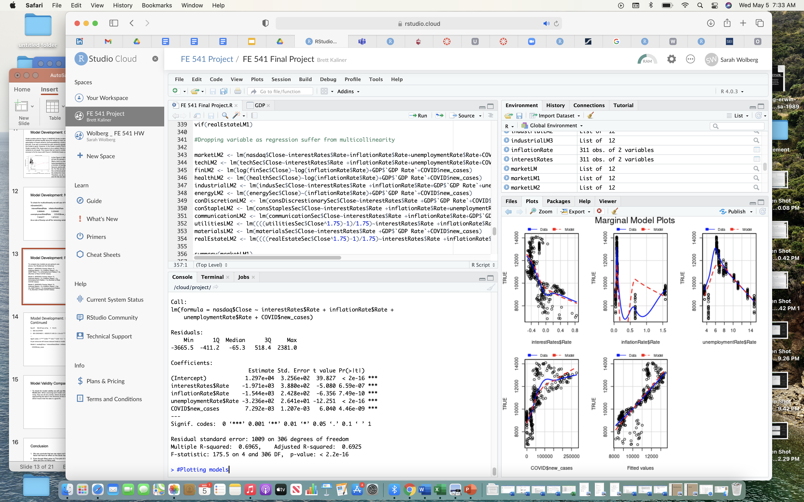
Model Development: Performance Comparison
Model 1
Model 2

Slide 15
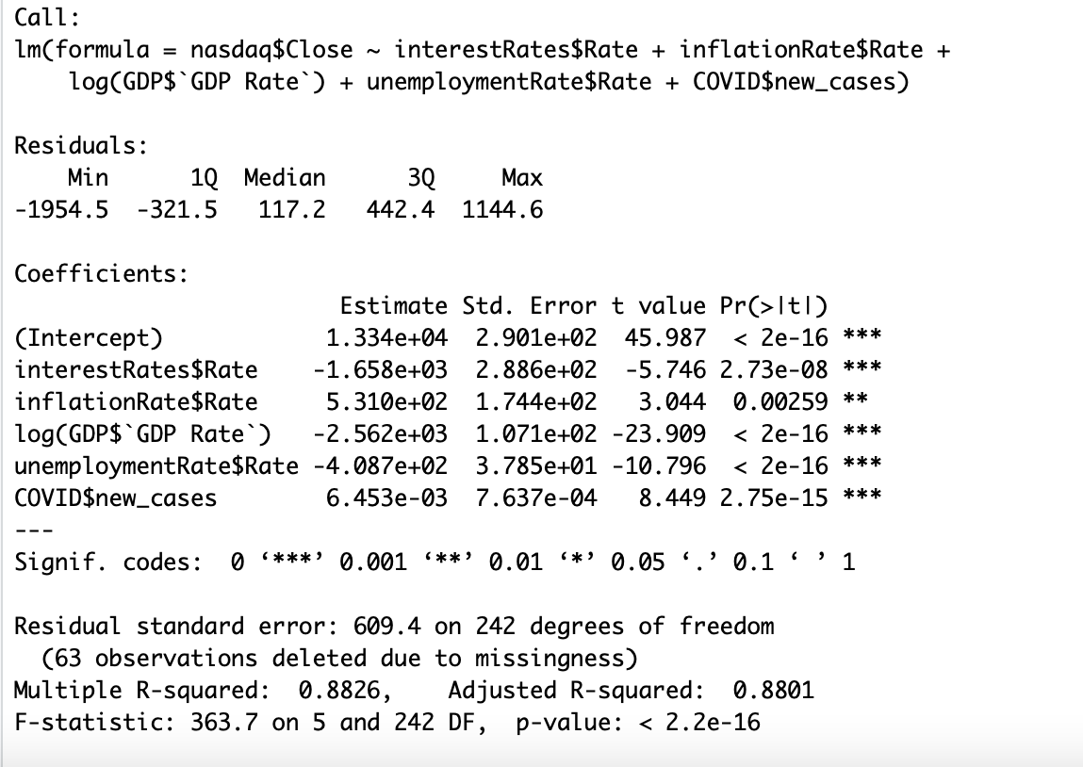
Model Development: Performance Comparison
Model 3
Model 1 has an R-Sqared value of 0.7765 in comparision with Model 2 R-Sqared value of 0.6965. Taking a variable away in Model 2 shows that taking away variables does not make the model better. This lead us to then take the LOG of GDP. This was Model 3 which ended up being a very good model with an R-Squared Value of 0.8826.

Slide 16
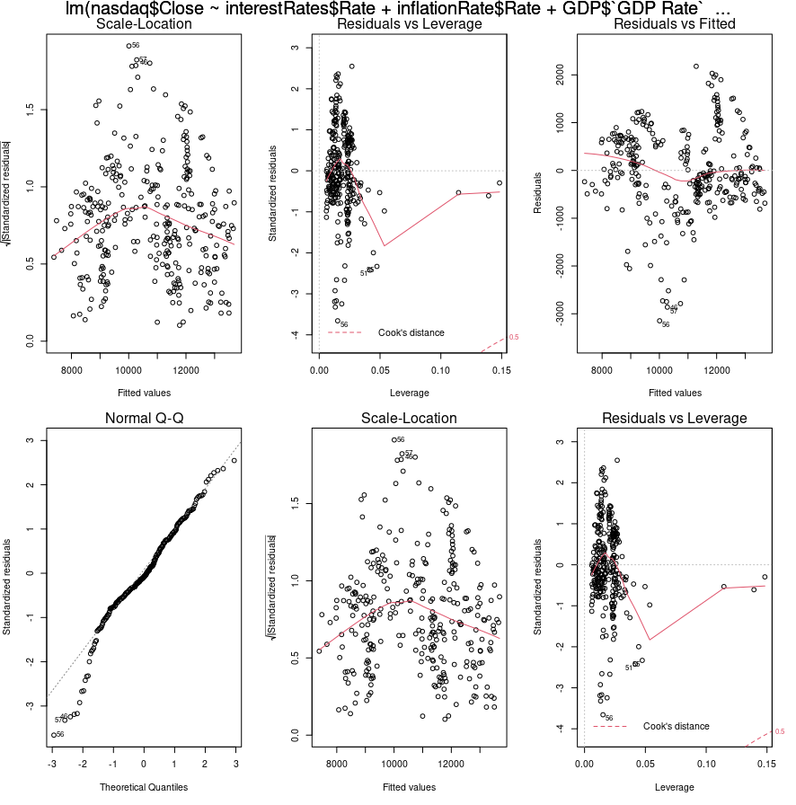
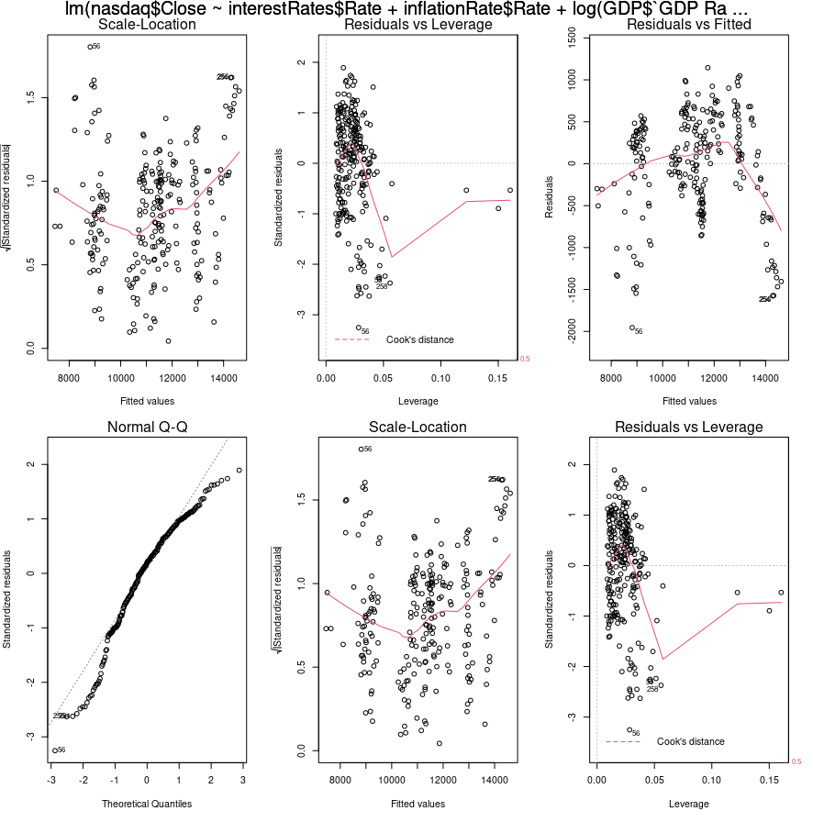
Model Development: Performance Comparison
Model 1
Model 3

Slide 17
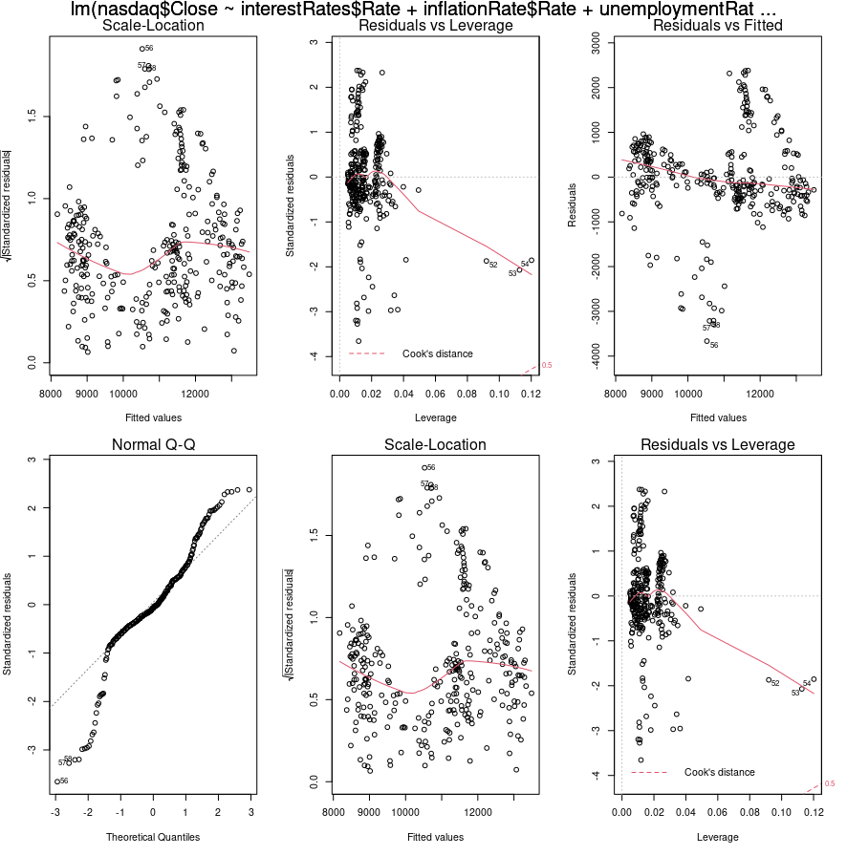
Model Development: Performance Comparison
Model 2
Model 3

Slide 18
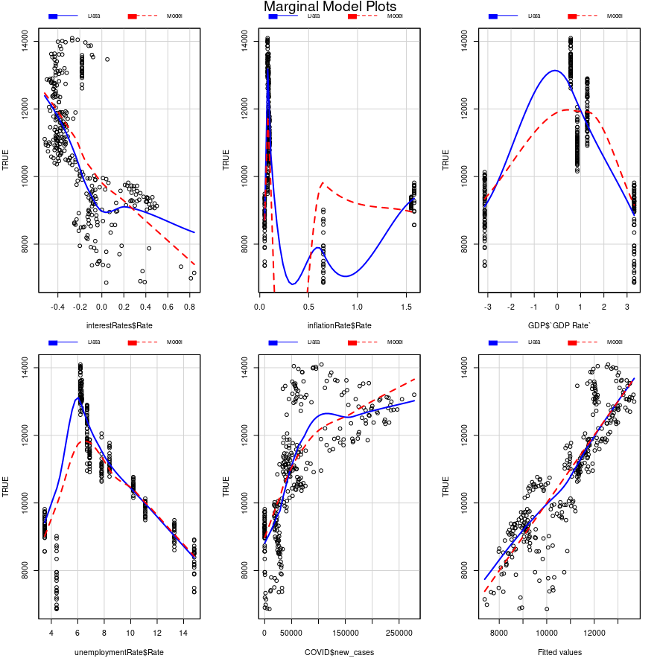
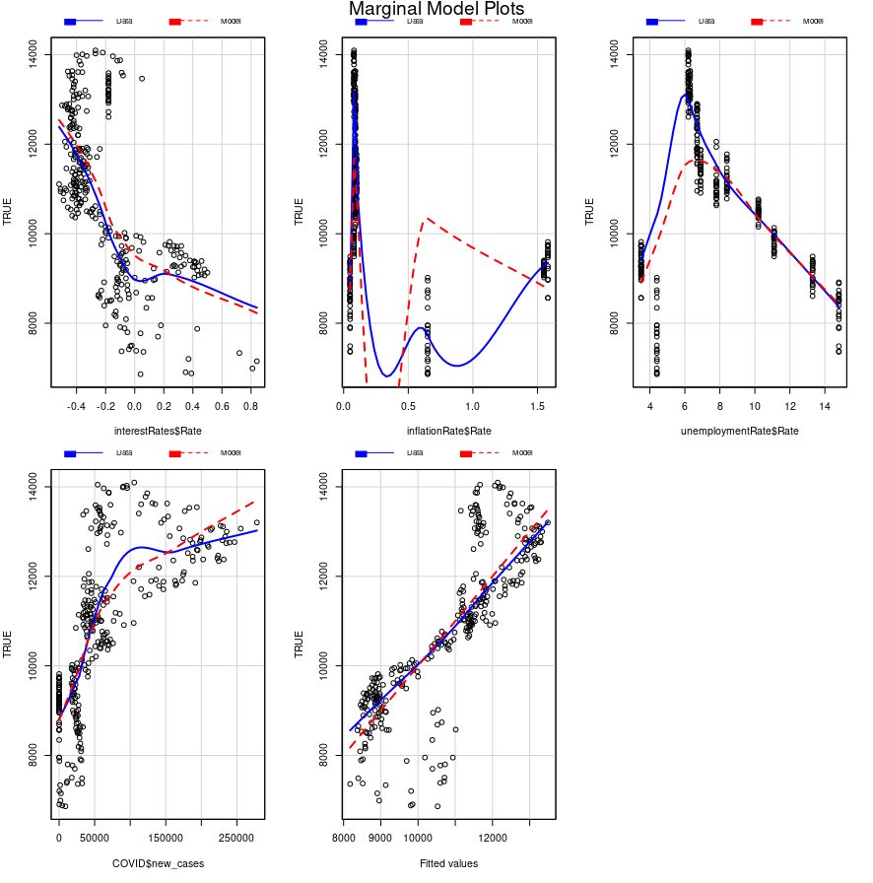
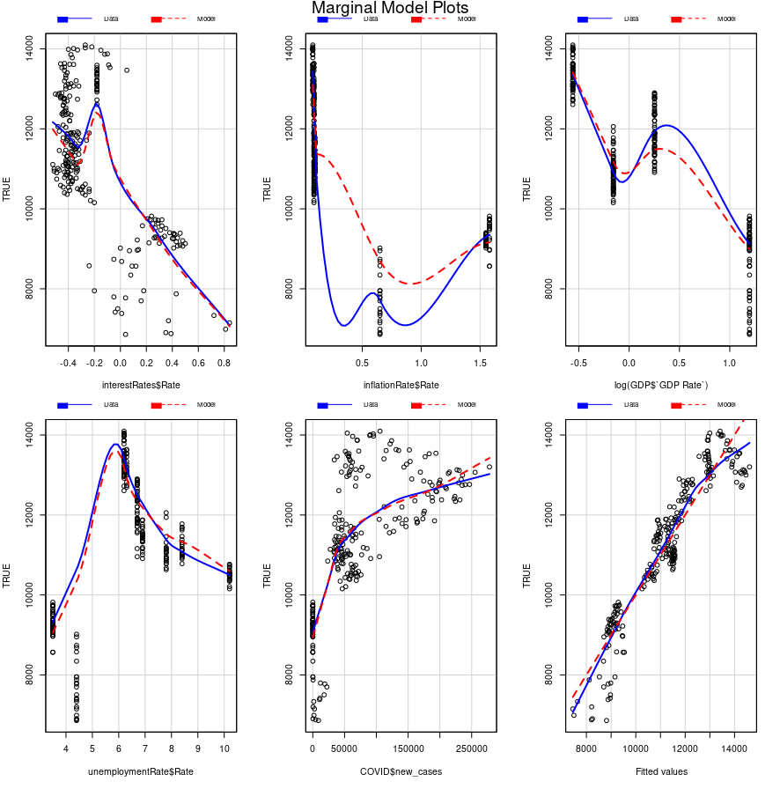
Model Validity Comparison
To check for model validity for each model, we used Marginal Model Plot (mmp). When assessing each model using mmp, they are all very similar, where all models are approaching the data in the direction of the data which means that the data is a good fit. However, we can see that Model 3 is a better fit than both Model 1 or Model 2.
Model 1
Model 2
Model 3

Slide 19
Conclusion
We can conclude that we can reject null hypothesis and say that COVID-19 and other external factor did have an effect on the stock market.
To check for model validity for each model, we used Marginal Model Plot (mmp). When assessing each model using mmp, they are all very similar, where all models are approaching the data in the direction of the data which means that the data is a good fit. However, we can see that Model 3 is a better fit.
Model 3 is the best model of the three models with an R-Squared Value of 0.8826. Model 1 has an R-Squared value of 0.7765 in comparison with Model 2 R-Squared value of 0.6965. Taking a variable away in Model 2 shows that taking away variables does not make the model better. This lead us to then take the LOG of GDP.

Slide 20
Discussion
Our Analysis shows that COVID-19 did have an effect on the Stock Market.
More research is required to see if other markets were also affected.

Slide 21
Limitations
We only looked at the NASDAQ. We need to look at other sectors of other industries such as the technology, health care, industrial, energy, communications, materials, and real estate for further analysis. This will give us a better picture on the how and what markets COIVD-19 has affected these market spaces.
We looked at some major market factors, but we did not look at all factors in the market. If we look at more factors, this may help strengthen the accuracy of our models.

Slide 22
Future Work
We need to look at other sectors of other industries such as the technology, health care, industrial, energy, communications, materials, and real estate for further analysis. This will give us a better picture on the how and what markets COIVD-19 has affected these market spaces.
Look at additional factors or variables that may affect the market to see if this strengthens the models.

Slide 23
Data Resources
Data | Variable | Date Accessed | Site Accessed
NASDAQ Composite(^IXIC) | Y | 3/29/21 | https://finance.yahoo.com/quote/%5EIXIC/history?period1=1522281600&period2=1616976000&interval=1d&filter=history&frequency=1d&includeAdjustedClose=true
Inflation Rates | X₁ | 3/29/21 | https://fred.stlouisfed.org/graph/?g=cN69
Interest Rate Data | X₂ | 3/29/21 | https://www.treasury.gov/resource-center/data-chart-center/interest-rates/Pages/TextView.aspx?data=reallongtermrateAll
GDP | X₃ | 3/29/21 | https://fred.stlouisfed.org/graph/?g=cN69
Unemployment Data | X₄ | 3/29/21 | https://fred.stlouisfed.org/series/UNRATE
COVID Case Data | X₅ | 3/29/21 | https://ourworldindata.org/coronavirus/country/united-states

Slide 24
Research Resources
L. Bauer, K. Broady, W. Edelberg, J. O’Donnel, “Ten Facts About COVID-19 and the US Economy, accessed on 14 April 2021 (https://www.brookings.edu/research/ten-facts-about-covid-19-and-the-u-s-economy/).
A Pak, O. Adegboye, A. Adekunle, K. Rahnman, E. McBryde, and D. Eisen, Economic Consequences of the COVID-19 Outbreak: the Need for Epidemic Preparedness, accessed on 14 April 2021 (https://www.frontiersin.org/articles/10.3389/fpubh.2020.00241/full ).

